Slide 1

An analysis on driving factors behind Singapore government’s operating expenditure
James Oon
Luo Shao Xuan

Slide 2
Why we chose this topic
We know that SG government is fiscally prudent and we want to know the driving factors that help the government maintain its fiscal position.
Fiscal position is a topic close to our hearts as it influences the Government budget, and major decisions such as GST rate hikes and payouts, etc.
We realised early on that we can reconcile the Overall Fiscal Position against Revenue and Expenditure*. We did a pivot using Total Expenditure table and found out:
Overall Fiscal Position = Total Revenue – Total Expenditure
* See appendix on pivot table
With this knowledge, we can come up with this inference:
Expected Fiscal Position = Expected Total Revenue – Expected Total Expenditure
Given the time constraint, we decided to focus our efforts on understanding the driving factors behind Total Expenditure.

Slide 3
Data Exploration
We did a high level analysis on all five tables provided:
 | Govt Expenditure by Type | Govt Fiscal Position | Govt Manpower | Govt Operating Revenue | Govt Total Expenditure
Start Year | 1997 | 1997 | 1997 | 1997 | 1997
End Year | 2021 | 2023 | 2023 | 2023 | 2023
Granular level 1 | Key field: Type Operating Development | Key field: Category Balance Expenditure Revenue |  |  | Key field: Type Operating Development
Granular level 1.5 | Key field: Category Operating – Running Costs, Transfers Development – Development
Granular Level 2 | Key field: Class 8 classes, not categorized by Ministry, unfamiliar |  |  | Key field: Class 3 types > Fees and Charges, Others, Tax
Granular Level 3 |  | Key field: Item 12 types > 4 under balance 6 under expenditure2 under revenue |  | Key Field: Type 14 types > 2 under Fees and Charges, 1 under Others, 11 under Tax
Granular Level 4 |  |  | Key field: Ministry 24 types, these are terms we are familiar with (i.e. Law, Education, Health) |  | Key field: Ministry 18 types > Social > 8, Economic > 4, Govt Admin > 4, Security and External Relations > 3 Manpower overlaps both Economic and Social
Key field: Actual_Revised_Estimate | 2021 > estimate, 2020 > revised, 2019 and before > actual | 2023 > estimate 2022 > revised 2021 and before > actual | 2023 > estimate 2022 > revised 2021 and before > actual | 2023 > estimate 2022 > revised 2021 and before > actual | 2023 > estimate 2022 > revised 2021 and before > actual

Slide 4
Data Preparation
Thought process 1: Two assumptions to be validated
A. The SG government is fiscally prudent and usually runs a net positive fiscal position.
B. Operating expenditure does not change much over the years, but development expenses may change depending government policies.
# Validate Assumption A
# Using Item column in Govt Fiscal Position table, filter only records which reflect Overall Fiscal Position.
# Create a function to identify positive/negative amounts.
# Create a new column called 'Positive?'. Use the above function to map the amounts into string ‘Positive’ or ‘Negative’.

Slide 5
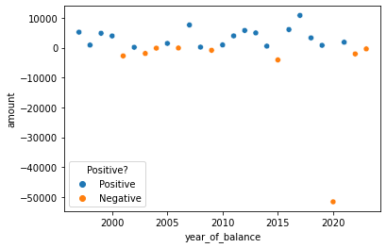
Data Preparation
Use scatterplot to identify the distribution of positive versus negative years.
We observe that out of 27 years, the government is in deficit for only 9 years.
We also observe an outlier in year 2020, where the government ran a huge deficit, most likely due to covid.

Slide 6
Data Preparation
Thought process 1: Two assumptions to be validated
A. The SG government is fiscally prudent and usually runs a net positive fiscal position.
B. Operating expenditure does not change much over the years, but Development expenses may change depending government policies.
# Validate Assumption B
# Take the Total Expenditure table, do a groupby financial_year and type.
# Reset the financial_year and type from index back to columns
# Import matplotlib and seaborn

Slide 7
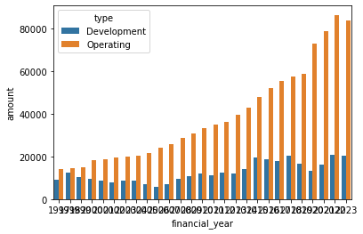
Data Preparation
Create a barplot to plot the trend of Development and Operating expenditures over the year.
Operating expenditure has risen significantly over the years, from 14 billion to 83 billion.
On the other hand, Development expenditure has only experienced a more gradual increase, from 10 billion to 20 billion.
We made a correction on Assumption B.

Slide 8
Conclusion on Data Preparation
We can see from the earlier scatterplot that in most years the government ran a positive fiscal position.
Operating expenditure has risen significantly over the years, but Development expenditure has only experienced slight increase.
# This brings us to the 1st Hypothesis

Slide 9
Hypotheses
- Hypothesis 1
If govt fiscal position is negative this year, in the next year, the total operating expenditure will decrease.
To do this, I need to combine fiscal position and government total expenditure tables.
I need to calculate change in total operating expenditure between this year and previous year.
I can use scatterplot to take overall last year's fiscal position to compare against this year's change in total operating expenditure
# Merge filtered Govt Fiscal Position with filtered Govt Total Expenditures tables on financial year based on inner join.
# Filter only records where Type = 'Operating'.
# Create a new column called 'diff_amount' to compare between this year and previous year total operating expenses.
# Create a new column called 'last_yr_x' to extract last year's fiscal position.

Slide 10
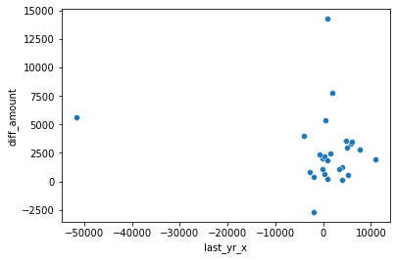
Hypothesis Testing
Create a scatterplot to compare independent variable previous year fiscal position with dependent variable delta in total operating expenses.
Data is skewed and there is no observable trend.
We need to remove outlier for year=2021

Slide 11
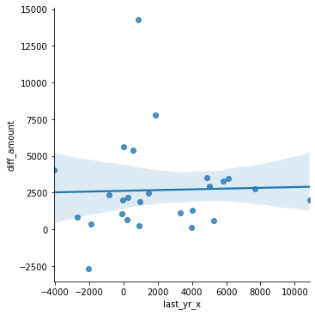
Hypothesis Testing
We removed outlier for year=2021
Create lmplot to compare independent variable ‘last year Overall Fiscal Position’, against dependent variable ‘difference in Total Operating Expenditure’.
Import scipy and calculated the slope (or correlation) between independent and dependent variable.

Slide 12
Conclusion on Hypothesis Testing 1
We can observe there is a negligible correlationship of 0.025366 between previous year's fiscal position, and the delta in operating expenditure between current and previous year.
We believe there are other factors that could affect operating expenditure.
# This brings us to the 2nd Thought Process

Slide 13
Data Preparation
Thought process 2:
We wanted to understand the trend in manpower between 1997 and 2023.
We took the manpower table, groupby financial year to calculate total manpower headcount for each year.

Slide 14
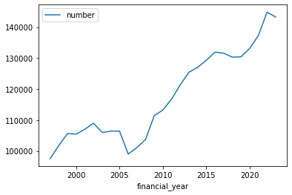
Data Preparation
Create a simple line plot to understand the trend
We observe an increase in government manpower headcount over the years, from less than 100,000 (1997) to more than 140,000 (2023).

Slide 15
Hypotheses
- Hypothesis 2
We think an increase in headcount could also have an impact on operating expenditure.
# Create a new column in Manpower table called 'diff_headcount', to calculate change in manpower headcount between this year and previous year.
# Merge Manpower with filtered Total Expenditure table on financial year using inner join.

Slide 16
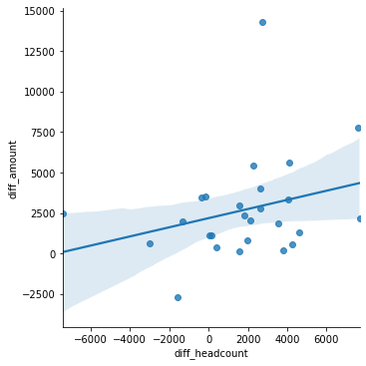
Hypothesis Testing 2
Create lmplot using independent variable difference in manpower headcount against dependent variable difference in operating expenditure
Remove year 1997 data with NaN value
Calculate the slope (correlation)

Slide 17
Conclusion on Hypothesis Testing 2
We can observe a stronger correlationship of 0.28224 between change in headcount and delta in development expenditure.
We think that using both independent variables together - previous year's fiscal position and change in headcount - can give us a reasonable prediction on delta in operating expenditure.
# This brings us to the 3rd Hypothesis

Slide 18
Hypotheses
- Hypothesis 3
The government’s previous year's fiscal position and change in manpower headcount has an influence on total operating expenditures

Slide 19
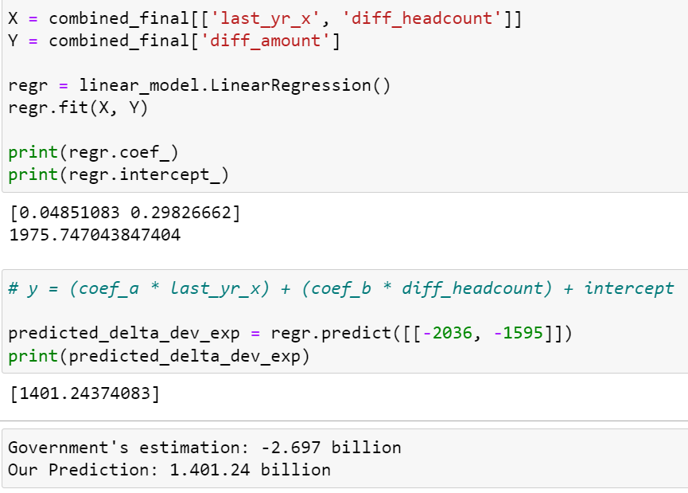
Hypothesis Testing 3
Import linear model from sklearn
Convert NaN values to 0 for year 1997 data
Create a multi-linear regression model
Use two independent variables - 1. previous year's fiscal position and 2. change in manpower headcount against one dependent variable - delta in operating expenditure
Calculate the intercept and coefficients

Slide 20
Overall Conclusion
Given that our prediction is significantly different from government’s estimation, more research is required to understand other factors in play that can affect Operating expenditure.
Instead of using aggregated manpower and fiscal position numbers, we can analyse data at a more granular level, for example into each ministry, understand the individual driving factors to predict their expenses, then consolidate into an overall number.
The model is also simplistic in that we assume SG government only considers previous year's fiscal position and change in manpower headcount, when in reality it would have taken a longer time horizon (i.e past 5 or 10 years change in fiscal position and change in manpower headcount)

Slide 21
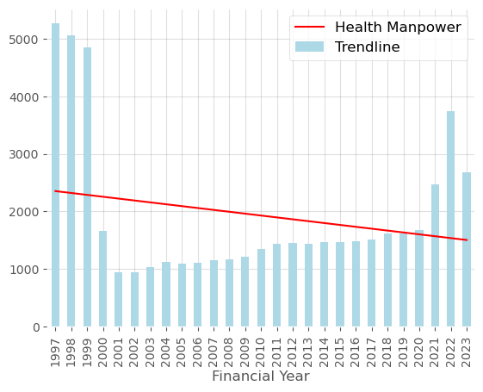
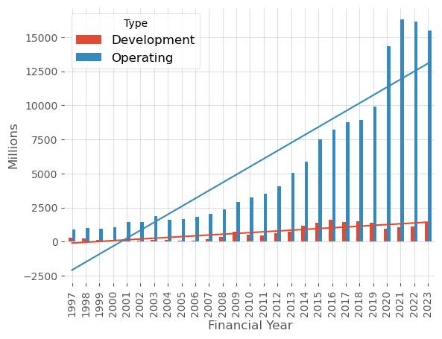
Data Preparation for Health
From the existing two files a simple plot of the data shows the following
From the Health manpower filtered data it’s observed that the over the years manpower has dropped with exception of the COVID years in 2021. A general trend line also seems to show that
From the Health expenditure filtered data, it’s also observed the operating expenses are spiking high significantly higher than the development expenses.
We needed to combine the datasets of the from manpower and expenditure to get a better view of manpower and expenditure of government

Slide 22
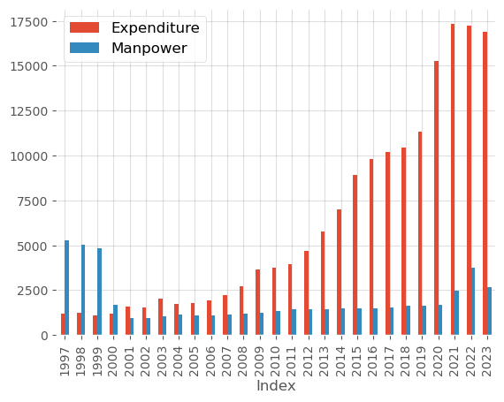
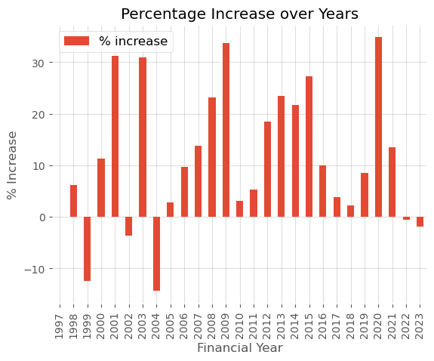
Data Preparation for Health
As we have not view of the breakdown of the specifics for operating expenditure, we combine the operating and development expenses and contrast that with the manpower growth
We derived the percentage increase over the years to gain better insight of the yearly increase/decrease

Slide 23
Hypotheses
- Hypothesis 4
Aging population a factor in the increase of healthcare expenditure

Slide 24
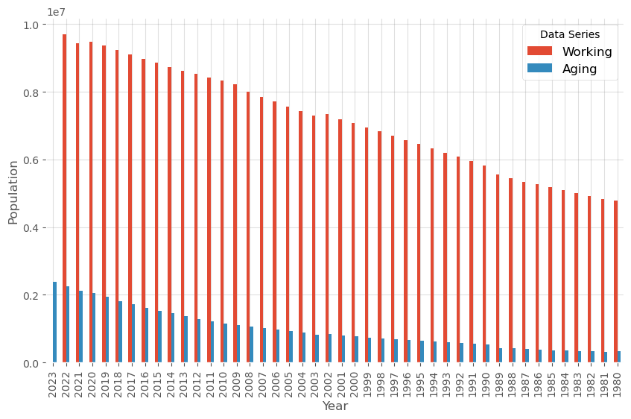
Data Wrangling
To determine this we have to augment the existing dataset externally from SingStats website. This data only represents Singapore citizens
Basic data wrangling was performed, and data was segregated into Working and Aging population by year and from the graph it’s clear than population is aging gradually

Slide 25
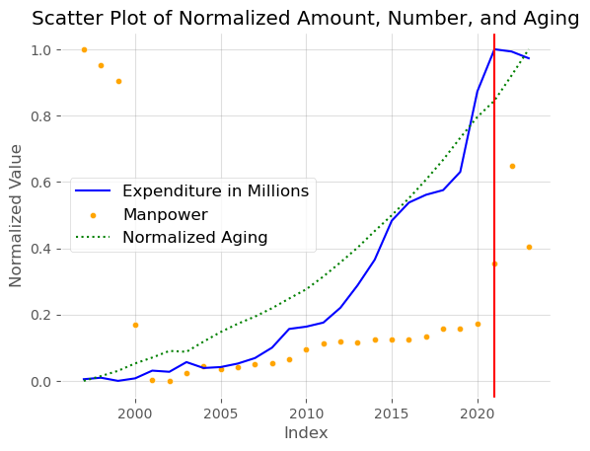
Hypothesis Testing 4
Import external population data set
Data wrangle to separate working and aging adult e.g. > 64 years of age
Normalised the total count to display on the graph
Clearly from the graph the age curve is similar to the expenditure. It’s therefore evidence to show part of the expenditure grown is related to aging population

Slide 26
Overall Conclusion on health expenditure
While initial visualization seems to indicate there are a correlation but without additional details it may be inconclusive to infer that only one variable i.e. aging population is the main reason for the rise on government expenditure
Other aspect that is unknown that may be part of the government strategy to invest more on population health now to prevent the ‘cure’ may impact the expenditure curve

Slide 27
Appendix
Government Fiscal Position table – Comparison between Fiscal Position and Revenue/Expenses
Except for 2021-2023, we can reconcile the Overall Fiscal Position against Revenue and Expenditure
Sum of amount | category
year_of_balance | Balance | Expenditure | Revenue | Revenue - Expenditure | Lookup Fiscal Position | Diff (E - F)
1997 | 22,495.00 | 23,930.00 | 29,181.00 | 5,251.00 | 5,252.00 | - 1.00
1998 | 3,752.00 | 26,986.00 | 27,911.00 | 925.00 | 925.00 | -
1999 | 20,521.00 | 25,761.00 | 30,645.00 | 4,884.00 | 4,885.00 | - 1.00
2000 | 13,993.00 | 29,743.00 | 33,726.00 | 3,983.00 | 3,983.00 | -
2001 | - 6,479.00 | 32,569.00 | 29,871.00 | - 2,698.00 | - 2,698.00 | -
2002 | - 4,186.00 | 28,954.00 | 29,144.00 | 190.00 | 191.00 | - 1.00
2003 | - 10,746.00 | 29,102.00 | 27,215.00 | - 1,887.00 | - 1,887.00 | -
2004 | - 4,145.00 | 30,618.00 | 30,512.00 | - 106.00 | - 105.00 | - 1.00
2005 | 1,468.00 | 29,463.00 | 30,948.00 | 1,485.00 | 1,486.00 | - 1.00
2006 | 36.00 | 33,475.00 | 33,420.00 | - 55.00 | - 55.00 | -
2007 | 28,756.00 | 35,124.00 | 42,780.00 | 7,656.00 | 7,656.00 | -
2008 | 2,381.00 | 45,190.00 | 45,429.00 | 239.00 | 239.00 | -
2009 | - 10,398.00 | 47,372.00 | 46,553.00 | - 819.00 | - 819.00 | -
2010 | 1,900.00 | 52,433.00 | 53,412.00 | 979.00 | 980.00 | - 1.00
2011 | 14,125.00 | 54,989.00 | 58,993.00 | 4,004.00 | 4,003.00 | 1.00
2012 | 23,806.00 | 57,864.00 | 63,684.00 | 5,820.00 | 5,821.00 | - 1.00
2013 | 17,591.00 | 60,312.00 | 65,309.00 | 4,997.00 | 4,998.00 | - 1.00
2014 | 5,666.00 | 69,004.00 | 69,576.00 | 572.00 | 571.00 | 1.00
2015 | - 17,717.00 | 77,816.00 | 73,766.00 | - 4,050.00 | - 4,050.00 | -
2016 | 5,317.00 | 77,417.00 | 83,541.00 | 6,124.00 | 6,125.00 | - 1.00
2017 | 24,128.00 | 79,678.00 | 90,540.00 | 10,862.00 | 10,861.00 | 1.00
2018 | - 3,182.00 | 86,813.00 | 90,151.00 | 3,338.00 | 3,339.00 | - 1.00
2019 | - 1,998.00 | 90,466.00 | 91,312.00 | 846.00 | 845.00 | 1.00
2020 | -174,614.00 | 137,188.00 | 85,620.00 | - 51,568.00 | - 51,567.00 | - 1.00
2021 | - 28,341.00 | 102,278.00 | 102,852.00 | 574.00 | 1,880.00 | -1,306.00
2022 | - 42,508.00 | 118,482.00 | 111,889.00 | - 6,593.00 | - 2,036.00 | -4,557.00
2023 | - 21,563.00 | 127,590.00 | 120,179.00 | - 7,411.00 | - 355.00 | -7,056.00

